Slide 2

Session Details
Building AI-Enabled Apps With .NET MAUI And Azure Cognitive Services
Aditya Oberai
Developer Advocate @ Appwrite
Microsoft MVP – Developer Technologies

Slide 3
Agenda
Azure Cognitive Services
Computer Vision API
.NET MAUI
Example App

Slide 4

Azure Cognitive Services

Slide 5
Cloud-based services with REST APIs and client library SDKs available to help you build cognitive intelligence into your applications

Slide 6
Benefits of Azure Cognitive Services
Customizable, pre-trained models
Deploy anywhere
No ML expertise required
Strict ethical standards
Notes:
Create customizable, pretrained models built with breakthrough AI research
Deploy Cognitive Services anywhere from the cloud to the edge with containers
Get started quickly—no machine-learning expertise required
Developed with strict ethical standards, empowering responsible use with industry-leading tools and guidelines

Slide 7
Categories of Azure Cognitive Services
Vision
Speech
Language
Decision
Search
OpenAI
Notes:
Vision APIs
Computer Vision Analyze content in images and video.
Custom Vision Customise image recognition to fit your business needs.
Face API Detect and identify people and emotions in images.
Speech APIs
Speech to Text Transcribe audible speech into readable, searchable text.
Text to Speech Convert text to lifelike speech for more natural interfaces.
Speech Translation Integrate real-time speech translation into your apps.
Speaker Recognition ^{PREVIEW} Identify and verify the people speaking based on audio.
Language APIs
Language Understanding Build natural language understanding into apps, bots and IoT devices.
QnA Maker Create a conversational question and answer layer over your data.
Text Analytics Detect sentiment, key phrases and named entities.
Translator Detect and translate more than 90 supported languages.
Decision APIs
Anomaly Detector Identify potential problems early on.
Content Moderator Detect potentially offensive or unwanted content.
Personaliser Create rich, personalised experiences for every user.
Search APIs
Various Bing related services such as News Search, Image Search, Web Search, Autosuggest, Visual Search, etc.

Slide 8
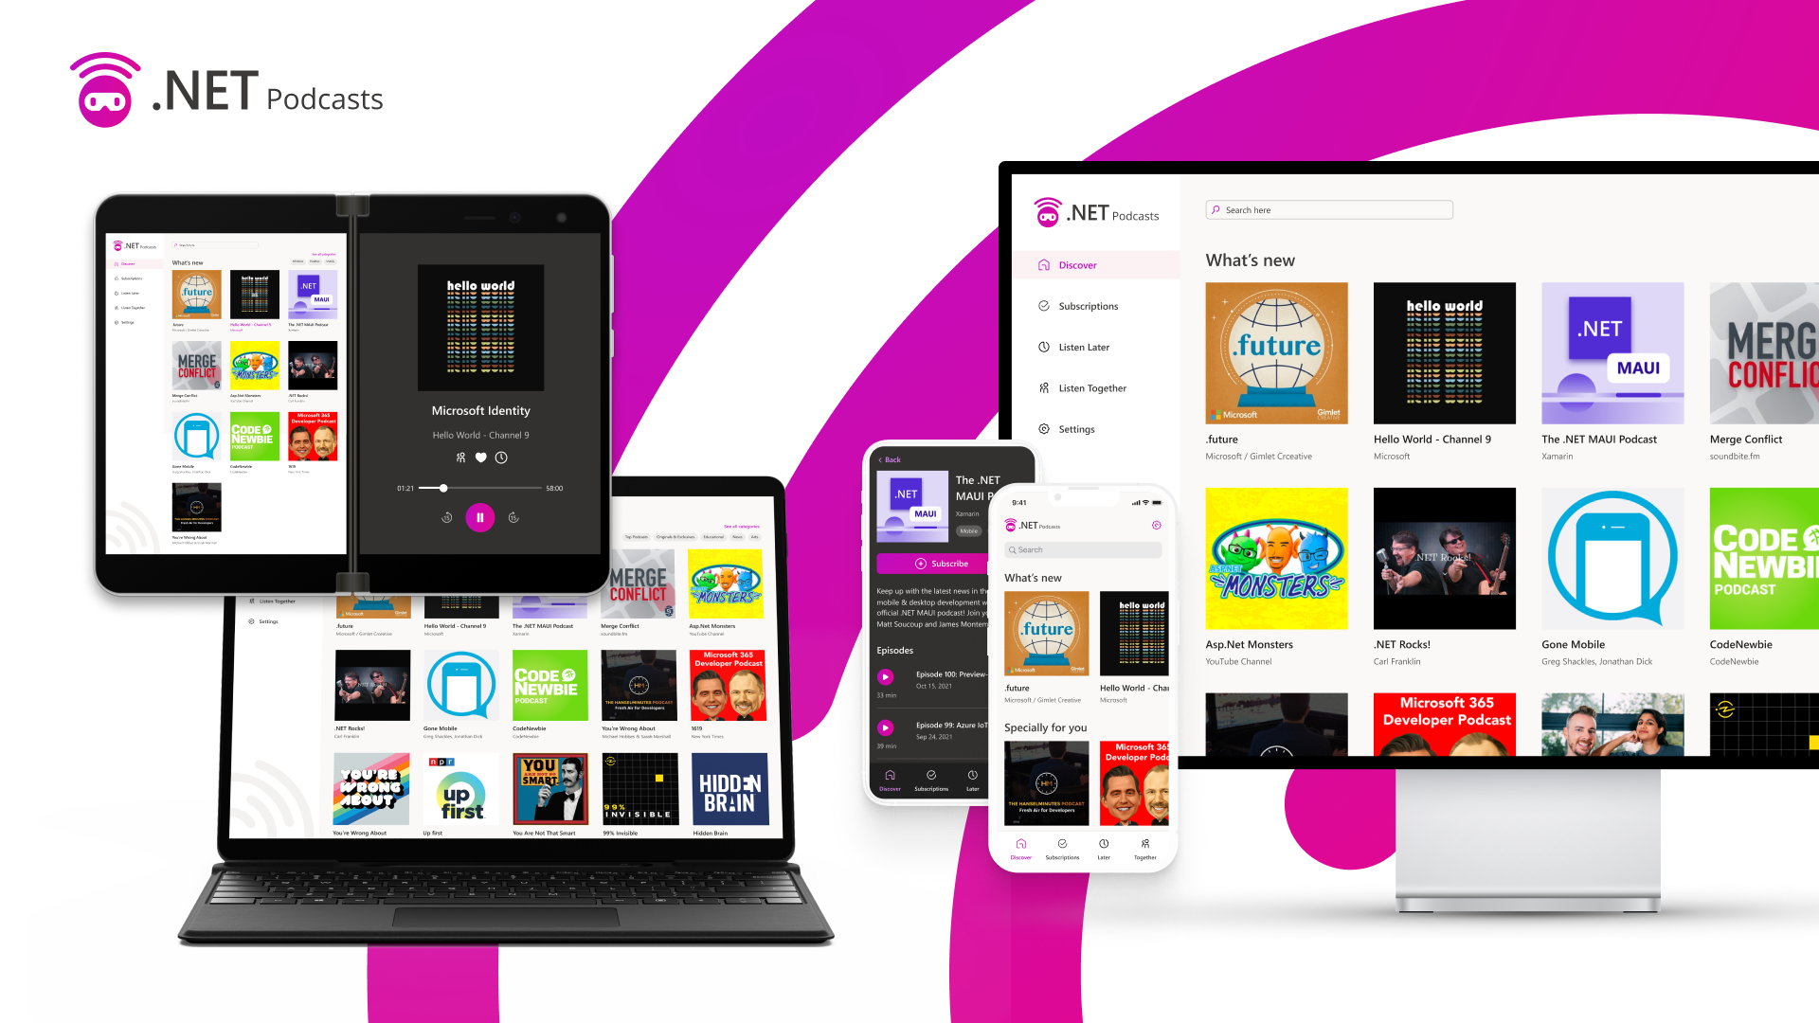

.NET MAUI

Slide 9
Cross-platform framework for creating mobile and desktop apps with C# and XAML

Slide 10

Example App

Slide 11
Prerequisites
An Azure Account
Computer Vision Resource
.NET 7
Visual Studio IDE 2022 (v17.3 or higher)
.NET Multi-platform App UI workload

Slide 12
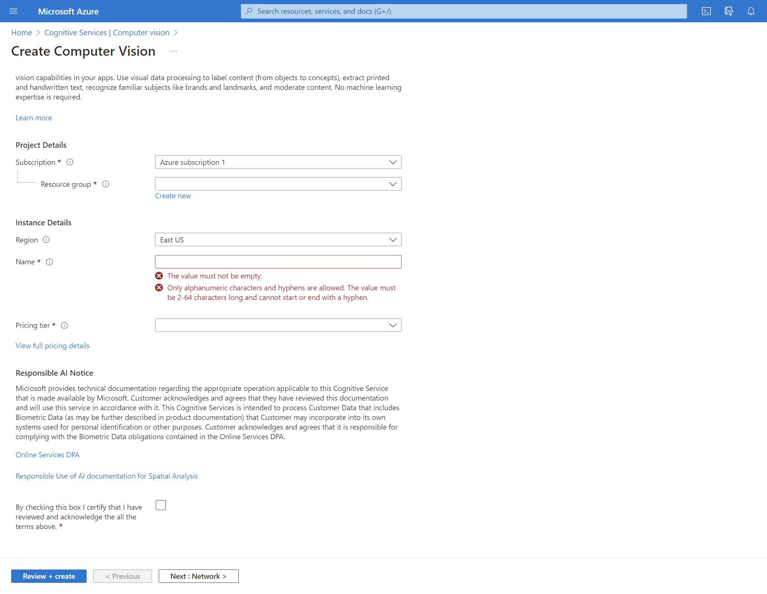
Create A Computer Vision Resource
Notes:
Create customizable, pretrained models built with breakthrough AI research
Deploy Cognitive Services anywhere from the cloud to the edge with containers
Get started quickly—no machine-learning expertise required
Developed with strict ethical standards, empowering responsible use with industry-leading tools and guidelines

Slide 13
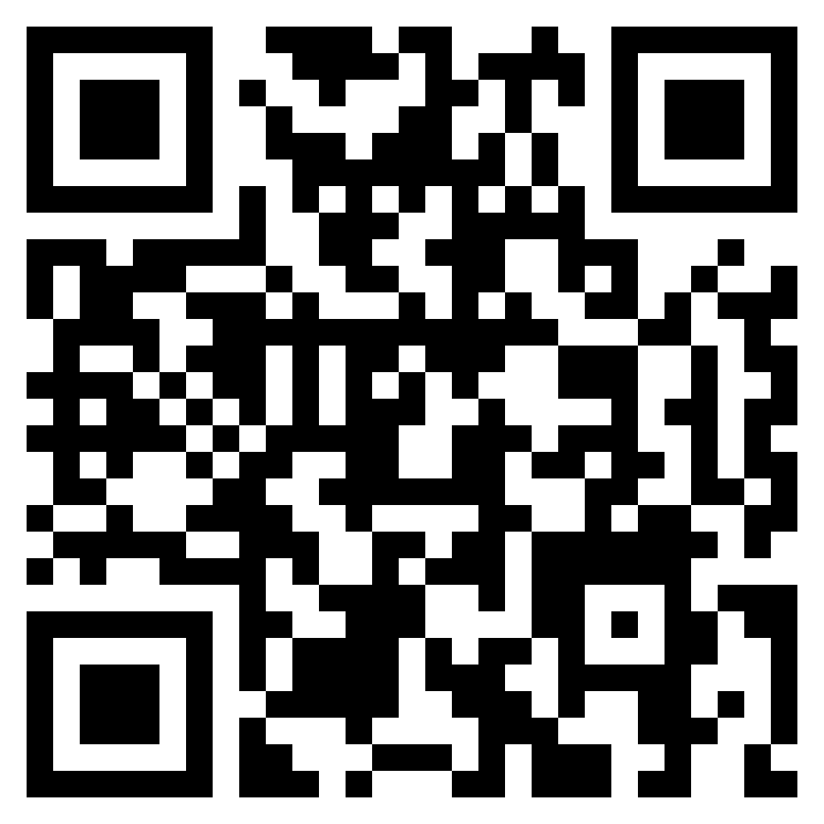
GitHub Link github.com/adityaoberai/GlobalAzureBLRDemo

Slide 14
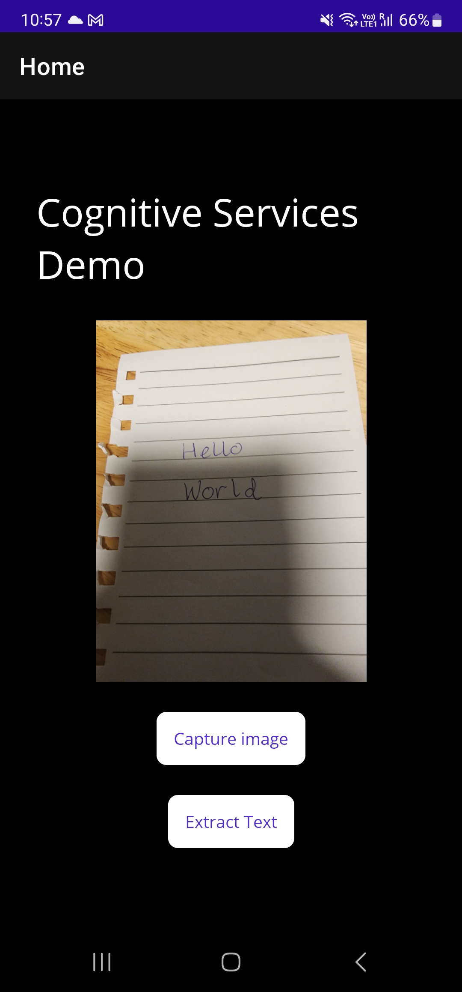
App UI
Notes:
Create customizable, pretrained models built with breakthrough AI research
Deploy Cognitive Services anywhere from the cloud to the edge with containers
Get started quickly—no machine-learning expertise required
Developed with strict ethical standards, empowering responsible use with industry-leading tools and guidelines

Slide 15
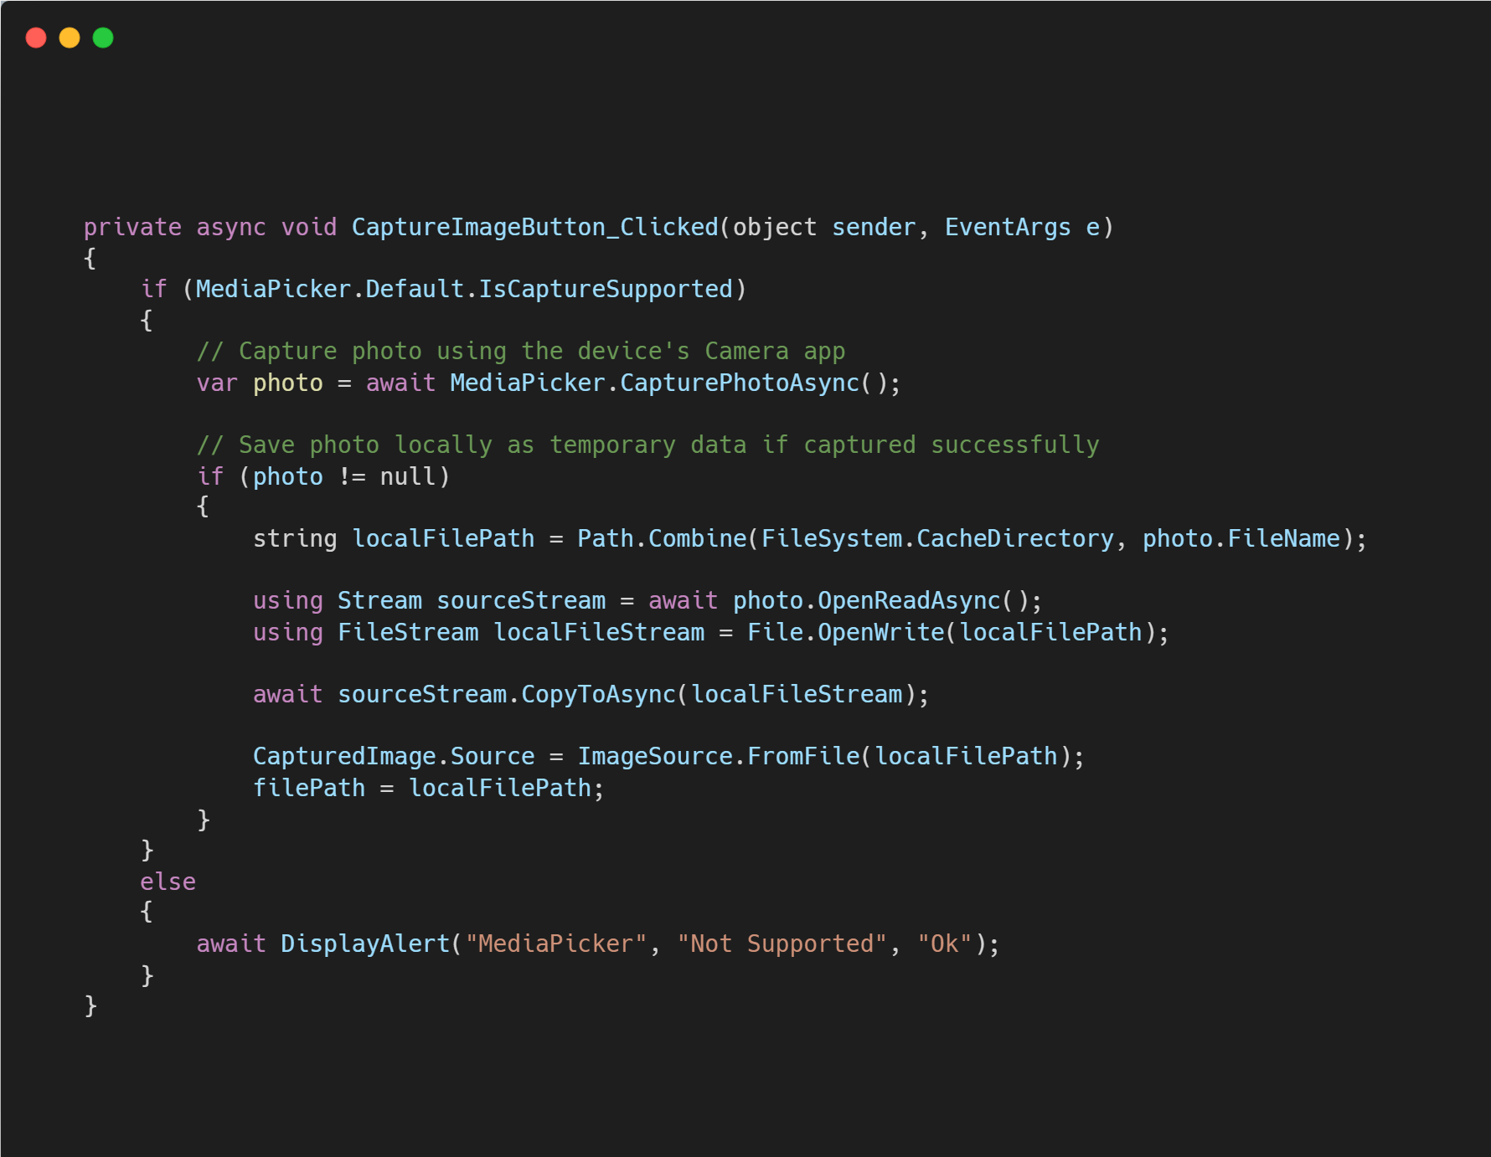
Capture Image
Notes:
Create customizable, pretrained models built with breakthrough AI research
Deploy Cognitive Services anywhere from the cloud to the edge with containers
Get started quickly—no machine-learning expertise required
Developed with strict ethical standards, empowering responsible use with industry-leading tools and guidelines

Slide 16
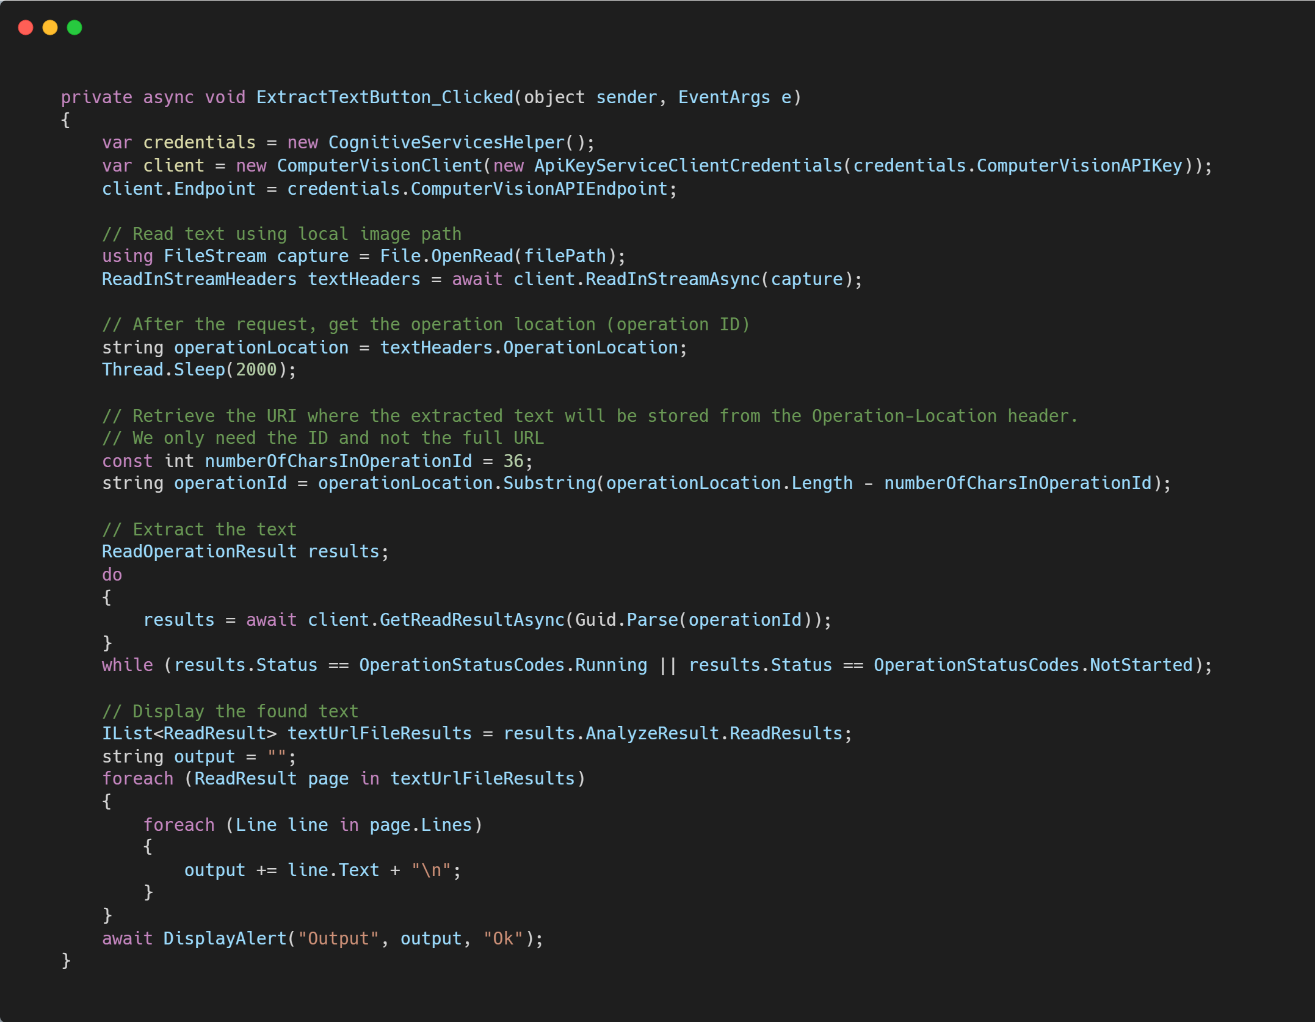
Extract Text
Notes:
Create customizable, pretrained models built with breakthrough AI research
Deploy Cognitive Services anywhere from the cloud to the edge with containers
Get started quickly—no machine-learning expertise required
Developed with strict ethical standards, empowering responsible use with industry-leading tools and guidelines

Slide 17

Functioning Application
Notes:
Create customizable, pretrained models built with breakthrough AI research
Deploy Cognitive Services anywhere from the cloud to the edge with containers
Get started quickly—no machine-learning expertise required
Developed with strict ethical standards, empowering responsible use with industry-leading tools and guidelines

Slide 18
Any Questions?
You can find me at: @adityaoberai1
oberai.dev

